Slide 1
Chapter 6 Part 2
Data Types

Slide 2
Chapter 6 Topics
Array Types
Associative Arrays
Record Types
Tuple Types
List Types

Slide 3
Heterogeneous Arrays
A heterogeneous array
Array in which the elements need not be of the same type
Supported by
Perl, Python, JavaScript, and Ruby
Actually implemented as
Homogenous arrays containing a generic data value
For example, an array containing Object values

Slide 4
Array Operations
APL
Powerful array operations for vectors, matrices & scalars
For example, to reverse column elements
Ada
Array assignment (copying operation)
Array catenation
Python
Array assignments are only reference changes
Array catenation and element membership operations
Notes:
Consider the following code in Python:
cars = ["Ford", "Volvo", "BMW"]
countries = ["USA", "Germany", "France"]
countries = cars
Here, a copy is not performed. Instead, a reference change results in the countries array referring to the cars array. Any change to the cars array will affect countries, and any change to the countries array will affect cars.

Slide 5
Array Operations
Java
Array assignments are also reference changes
A clone() method creates a copy
Ruby provides several, including array catenation
Fortran provides elemental operations
Operations between pairs of array elements
For example, + operator between two arrays results in an array of the sums of the element pairs of the two arrays
integer, dimension(3) :: A, B, C
A = (/ 3, 8, 5 /)
B = (/ 2, 1, 3 /)
C = A + B ! C contains 5, 9, 8

Slide 6
Rectangular and Jagged Arrays
A rectangular array
All rows have the same number of elements
All columns have the same number of elements
Fortran and Ada
A jagged matrix
Rows with varying number of elements
Actually represented as arrays of arrays
C, C++, and Java
C# and F#
Support both jagged and rectangular

Slide 7
Slices
A slice is some substructure of an array
Nothing more than a referencing mechanism that retrieves part of an array as a unit
Only useful in languages that manipulate arrays as units (therefore C does not support slices)
C++ supports slices using the valarray class

Slide 8
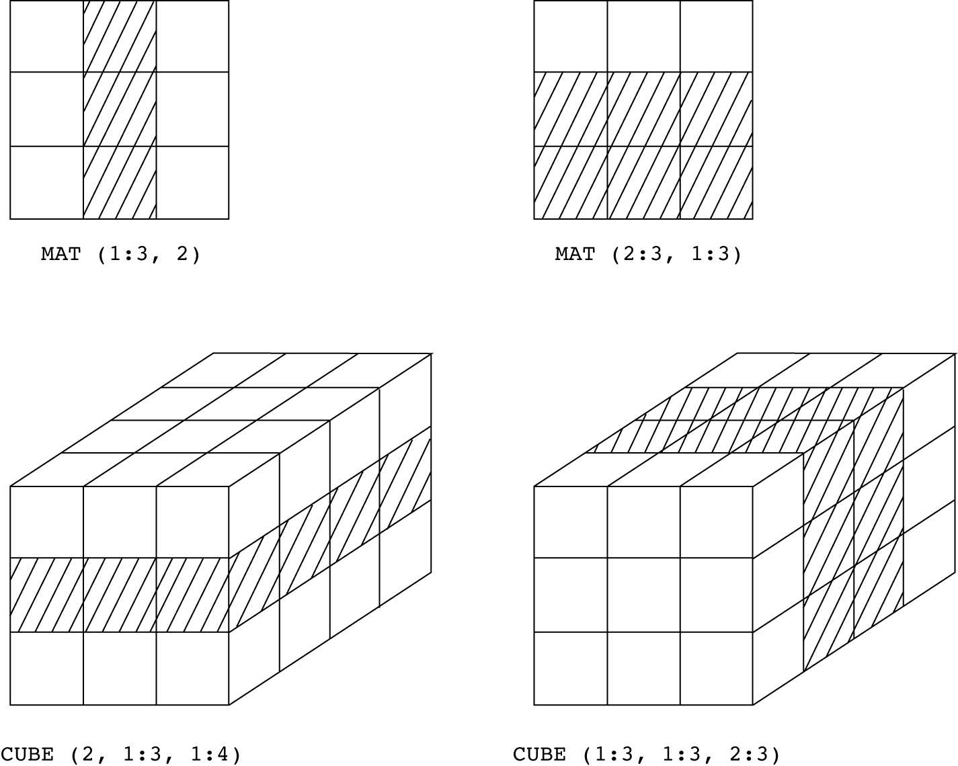
Examples of Slices in Fortran 95

Slide 9
Associative Arrays
An associative array
An unordered collection of data elements that are indexed by an equal number of keys
Requires that user defined keys must be stored
Design issues
What is the form of references to elements?
Do associative arrays have dynamic or static size?
Built-in type in Perl, Python, Ruby, Lua, and Swift
In Lua, they are supported by tables
In Perl, they are called hashes

Slide 10
Associative Arrays
In Perl
Names begin with % and parentheses delimit literal values
%hi_temps = ("Mon" => 77, "Tue" => 79, "Wed" => 65);
Subscripting is done using braces and keys
$hi_temps{"Wed"} = 83;
Elements can be removed with delete
delete $hi_temps{"Tue"};
Notes:
Perl keys must be strings, while values must be scalars (numbers, strings, or references). How does this affect orthogonality in Perl?

Slide 11
Record Types
A record
A possibly heterogeneous aggregate of data elements
Data elements are called fields, and identified by names
Design issues
What is the syntactic form of a field reference?
Are elliptical references allowed?

Slide 12
Records in COBOL
COBOL allows nested records
Level numbers show hierarchical structure
01 EMPLOYEE-RECORD.
02 EMPLOYEE-NAME.
05 FIRST PICTURE IS X(20).
05 MIDDLE PICTURE IS X(10).
05 LAST PICTURE IS X(20).
02 HOURLY-RATE PICTURE IS 99V99.
Notes:
COBOL records are not implemented as records within records. How does this affect the language evaluation criteria of COBOL?
How does the use of level numbers affect the language evaluation criteria for COBOL?

Slide 13
Orthogonal Records
Languages other than COBOL use records in records
For example, in Ada:
type Employee_Name_Type is record
First: String (1..20);
Middle: String (1..10);
Last: String (1..20);
end record;
type Employee_Record_Type is record
Employee_Name: Employee_Name_Type;
Hourly_Rate: Float;
end record;
Employee_Record: Employee_Record_Type;
Notes:
How does Ada’s use of records within records affect the orthogonality of the programming language?

Slide 14
References to Records
Record field references
COBOL
MIDDLE OF EMPLOYEE-NAME OF EMPLOYEE-RECORD
Other languages use dot notation
Employee_Record.Employee_Name.Middle
Fully qualified references
Must include all record names
Elliptical references
Allow leaving out record names if the reference is unambiguous
For example in COBOL, the following are all equivalent
FIRST
FIRST OF EMPLOYEE-NAME
FIRST OF EMPLOYEE-RECORD
Notes:
How does support for elliptical references affect (positively and negatively) the language evaluation criteria of a programming language?

Slide 15
Operations on Records
Assignment is very common
Generally types on both sides must be identical
COBOL provides MOVE CORRESPONDING
Copies all fields of the source record to the corresponding fields in the target record
Why does this make sense for COBOL?
Notes:
Why does the requirement that the records on both sides of the assignment must have the same type make sense? Can you think of a situation in which this might be a drawback?
How could a programming language support assignment between records of different types in certain circumstances? What problem might arise if a programming language supports this type of assignment?
Why does it make sense for COBOL to provide the MOVE CORRESPONDING operation?

Slide 16
Evaluation Compared to Arrays
Use records when data values are heterogeneous
Array element access slower than record field access
Subscripts are dynamic
Field names are static
Subscripts can simulate record fields dynamically
Array needs to store heterogeneous values
How would you go about achieving this?
Two drawbacks
Would disallow type checking (why?)
Would be much slower
Notes:
Try to answer the questions related to using array subscripts to simulate record fields.

Slide 17
Tuple Types
Similar to a record
However, the elements are not named
Used in Python, ML, and F#
Allow functions to return multiple values
In Python
Closely related to lists, but are immutable
Create with a tuple literal
myTuple = (3, 5.8, 'apple')
Referenced with subscripts (myTuple[1] references 3)
Catenation with + makes new tuple with elements of both
Can’t remove items, but del deletes tuple completely

Slide 18
Tuple Types
In ML
To create a tuple
val myTuple = (3, 5.8, 'apple');
To access the first element in myTuple
#1(myTuple)
A new tuple type is defined as follows
type intReal = int * real;
We can now use intReal wherever a type can appear (for example, as the type of a function parameter)
Notes:
In the last example, the intReal type represents a tuple containing an integer value and a real value.

Slide 19
Tuple Types
In F#
To create a tuple
let tup = (3, 5, 7)
Can assign a tuple to a tuple pattern
let a, b, c = tup
Here a, b, c is a tuple pattern, and statement assigns
the value 3 to a, the value 5 to b, and the value 7 to c
Notes:
There must be exactly as many names on the left hand side of the second let example, as there are values in tup. A type mismatch occurs if there are either too few or too many.
Tuples in F# are immutable by default, but can be specifically declared as mutable.

Slide 20
List Types
A list
Ordered sequence of often heterogeneous values
Typically represented as a linked list
Lists in LISP and Scheme
We’ve discussed these in Chapter 15

Slide 21
List Types
In ML
Supports list types
Written in brackets
Elements are separated by commas
List elements must be of the same type
The equivalent of the Scheme CONS function
The binary :: operator
3 :: [5, 7, 9] evaluates to [3, 5, 7, 9]
Equivalents of Scheme’s car and cdr functions
Named hd and tl, respectively
hd [5, 7, 9] evaluates to 5
tl [5, 7, 9] evaluates to [7, 9]

Slide 22
List Types
F# lists are similar to those in ML
Elements are separated by semicolons
Binary :: operator is the same as in ML
Equivalent to car in Scheme
List.head [1; 2; 3] evaluates to 1
Equivalent to cdr in Scheme
List.tail [1; 2; 3] evaluates to [2; 3]
Notes:
Note that the head and tail syntax is correct for standard ML, and differs from what is published in the textbook.

Slide 23
List Types
Python lists
Also serve as heterogeneous arrays
Python’s lists are mutable
Unlike lists in Scheme, Common LISP, ML, and F#
Elements can be of any type
Create a list with an assignment
myList = [3, 5.8, "grape"]

Slide 24
List Types
Python lists (continued)
List elements are referenced with subscripting
Indices begin at zero
For example, to set x to 5.8
x = myList[1]
List elements can be deleted with del
del myList[1]
Notes:
Using del on a list in Python will, of course, shorten the list by one element.

Slide 25
List Types
Python lists (continued)
List Comprehensions
list = [x ** 2 for x in range(12) if x % 3 == 0]
First, the variable x takes on integer values from 0 to 12
For each value divisible by 3 (that is 0, 3, 6, 9, and 12) it then computes the square (that is 0, 9, 36, 81, and 144)
Places these squared values into a new list
Therefore list contains [0, 9, 36, 81, 144]

Slide 26
List Types
List comprehensions in Haskell
For example
[n * n | n <- [1..5]]
defines the list [1, 4, 9, 16, 25]
List comprehensions in F# can create arrays
For example
let myArray = [|for i in 1 .. 5 -> (i * i)|];;
creates [1; 4; 9; 16; 25] and names it myArray

